Slide 2
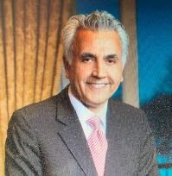
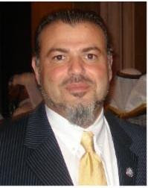
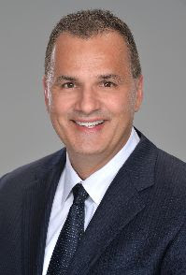
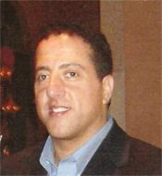
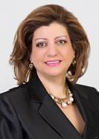
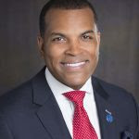
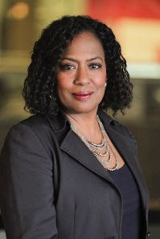
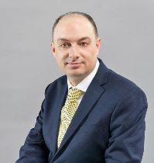
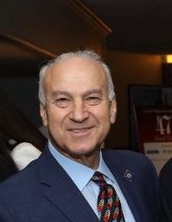
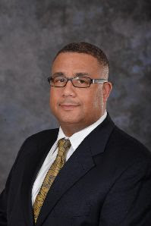
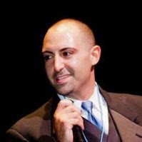
MEA TV & Radio Advisory Board
﻿Jacob Bacall Chairman of the Board
Bacall Development, President
Nabih Ayad, Vice Chairman of the Board
Founder of the Arab American Civil Rights League
Dennis Mouras, Board Member
CEO United Health Care
Nader Fakhouri, Board Member
CEO, C&A Consulting
Fay Beydoun, Board Member
Executive Director of American Arab Chamber of Commerce
Donnell R. White Board Member Senior Vice President, Chief Diversity Officer Chemical Bank
﻿Vickie Thomas, Board Member
City Beat Reporter, WWJ/Entercom Radio
Mark Kent Jones, Board Member
manager, Community Outreach, DTE Energy.
﻿Ziad Kassab, Board Member
﻿President of Dannys Home Health Care
Dr. Basel AL-Jabari, Board Member Executive Director of IABTT
Kamal Shohayeb, Board Member
Chairman and Founder
The Choice Group

Slide 3
YOUR COMMUNITY.
BUILDING BRIDGES OF UNDERSTANDING…
YOUR VOICE.
YOUR GUIDE.
BETWEEN THE MIDDLE EASTERN AMERICAN COMMUNITY & THE COMMUNITY AT LARGE…

Slide 4
History
MEA TV (Middle Eastern American TV) was established in 1991 with a mission to build bridges of understanding between the Middle Eastern community living and working in the United States and the community at large.
MEA TV features several diverse shows to cater to our mission including social and political talk shows, sports, interfaith, medical, entertainment, culture segments and live interactive shows that give our audience a chance to engage in the discussion of the various programs.
MEA TV provides coverage over politics, community issues, and cultural events that highlight the success and accomplishments of the Middle Eastern Americans in the United States.
The only Middle Eastern American media to cater to the community working
And living in the United States of America.

Slide 5
PROGRAMMING
Current Issues
Aghani Tahani
Mosaic
Samira’s Kitchen
The Night Show
Community Issues
Business & Investment
MedChat
Spotlight
Welcome to the D!
Backstage
Immigration Today Museum Politics Today
MEA TV has over 20 original weekly programs that are produced by MEA that cater to all areas of interest.
MEA also airs political, educational and social programs in addition to Arabic movies, soap operas, documentaries, various cultural and entertainment programs, and LIVE call- in programs that allows us to interact with our viewers.
Woman Zone
Arab American Talk Show
The Breakdown

Slide 6
MEA TV ONLINE STREAM
24 HOURS | 7 DAYS A WEEK

Slide 7
BROADCASTING PLATFORMS
B r o a d c a s t s 2 4 h o u r s 7 d a y s / w e e k
MEA TV Mobile Application
Available to all Apple and Android users through the App Store and Google Play Store
Live Stream
24/7 Live TV and Radio Streaming TV
www.meatv- radio.com/live-tv Radio
http://www.meatv
-radio.com/radio/

Slide 8
Audience Age Brackets
18-25 ------ 25%
26-40 ------ 71%
41-55 ------ 64%
56+ ------ 33%

Slide 9
United States: Middle Eastern American(9 million population) Canada: Arab Canadians (512,000 population)
Population
Target Audience

Slide 10
Target Audience Michigan: Market & Reach
Iraqi Christians (Chaldean)= 155,000
Shelby Twp.
Troy
Sterling Heights Warren
Walled Lake Farmington Hills Bloomfield Twp. West Bloomfield Oak Park Southfield Detroit
Livonia Redford Romulus
Lebanese Christians=161,000
Grosse Pointe
St. Clair Shores East Detroit Bloomfield Hills Farmington Hills Farmington Warren
Shelby Twp. Sterling Heights Redford
Yemeni=30,000
Detroit Dearborn
Iraqi Muslims=23,500
Detroit Dearborn
Lebanese Muslims
=75,000
Dearborn Dearborn Heights Farmington Hills Bloomfield Hills
Palestinian/ Jordanian= 43,500
Garden City Livonia
Redford Wayne Westland Northfield
Other=85,000
Syrian Egyptians Albanian Indian

Slide 11
U.S. DEMOGRAPHICS
TOP 10 STATES by Middle Eastern American Population
CALIFORNIA | MICHIGAN | NEW YORK | FLORIDA | TEXAS | D.C. METRO | NEW JERSEY | ILLINOIS | OHIO | MASSACHUSETTS
817,000 | 515,000 | 450,000 | 305,000 | 275,000 | 266,000 | 260,000 | 250,000 | 200,000 | 195,000
EDUCATION
POST GRADUATE | 22%
BACHELOR’S DEGREE | 41.7%
HIGH SCHOOL DIPLOMA | 85%
ANNUAL SPENDING POWER | $13 BILLION
HOME OWNERSHIP | 65%
AVERAGE HOUSEHOLD INCOME | $62,000
DOMINANCE IN PROFESSIONS
72% | MANAGERS
41% | ENTREPRENEURS
Research by AAI and Zogby International suggest that the Census Bureau estimate is likely significantly lower than the actual number of Arab Americans
in the country. The American Community Survey identifies only a portion of the Arab population through a question on “ancestry” on the census long form. Reasons for the undercount include the placement of and limit of the ancestry question (as distinct from race and ethnicity); the effect of the sample methodology on small, unevenly distributed ethnic groups; high levels of out-marriage among the third and fourth generations; and distrust/misunderstanding of government surveys among recent immigrants.
To learn more visit: http://www.aaiusa.org/pages/demographics

Slide 12
MEA RADIO
24 Hours 7 Days a week Live Stream Online Radio
App Available in the Apple App Store
App Available in the Google Play Store
Programming airs live on the web worldwide (www.meatv- radio.com/radio)

Slide 13
WHY ADVERTISE WITH MEA TV
Significant return on advertising investment.
Develop relationships with a large population with a purchase power of 13 billion annually.
Reach the diversified groups within the community through one platform
(niche market).
Gain long term, loyal customers.
Build up relationships through interactive TV & radio interviews.
Go beyond the traditional advertising, Social Media (Livestream, App,
Facebook, Instagram, Twitter and e-newsletter)
Communicate your message to your targeted customers.
Develop a dialogue with customers.
Targeted advertising (Michigan and all other areas in US with high population of Middle Eastern Americans )

Slide 14
BRIEF LIST OF MEA’S NORTH AMERICAN ADVERTISERS & PARTNERS
(PAST & CURRENT)

